Slide 1
Fingerprint Recognition Using Phase-based Image Matching
Rishabh Dahale - 17D070008
Shaurya Chopra - 170100108
Shyam Thombre - 170010023
Nitish Tongia - 170010042

Slide 2
Problem Statement and Approach
Robust fingerprint matching that works for low quality fingerprints, and is invariant of differences in minutiae caused by fingerprint surface conditions
Solution [1]:
Try to match phase of Fourier Transforms of database and probe image
Experimental evaluation demonstrates that phase retains information even for fingertips with difficult conditions, compared to minutiae based algorithms.

Slide 3
Dataset
Provided by FVC2004 [2]. FVC2004 is the third international Fingerprint Verification Competition
DB1 of the above dataset is used which contains images in 500 dpi resolution
Image size captured by sensors is 640x480
8 samples per person are given and samples from 10 people are provided

Slide 4
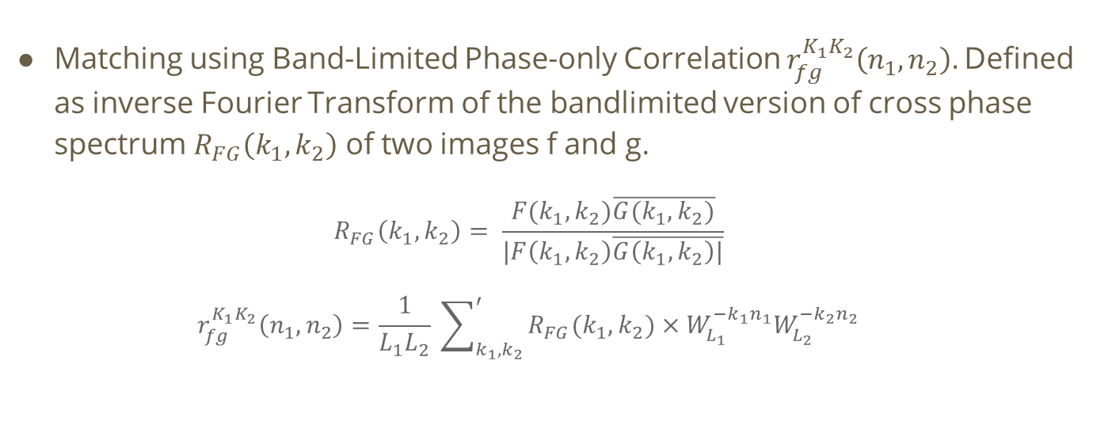
Algorithm - BLPOC

Slide 5
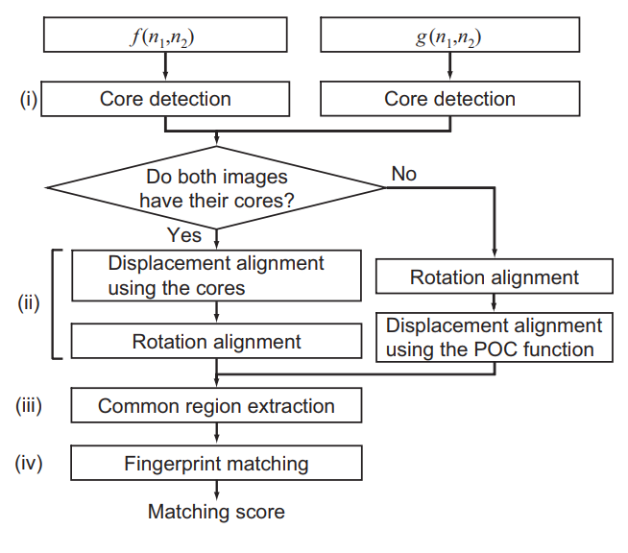
Algorithm

Slide 6
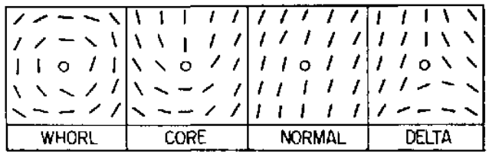
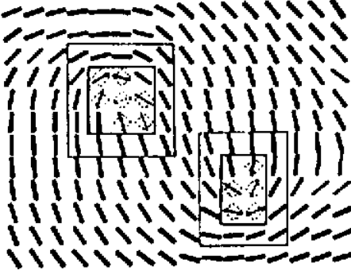
Algorithm - Core Points
Detect core points of the image
Compute direction patterns (block-wise histogramming); relaxation for noise reduction
Ridge line curvature around non-overlapping blocks using Poincare Index

Slide 7
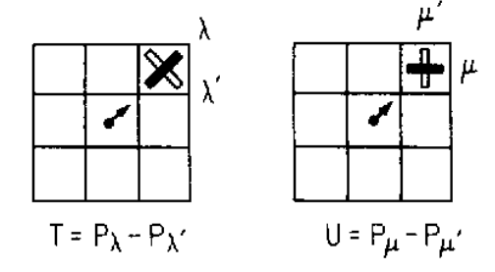
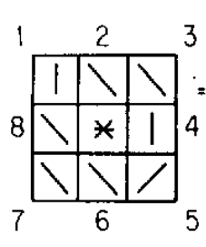
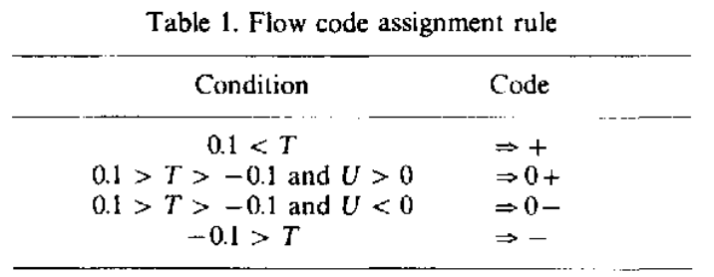
Algorithm - Core Points
Flow Encoding for core points
Rules for code reduction:
0+ , 0- ⇒ +
0- , 0+ ⇒ -
+ , 0* ⇒ +
- , 0* ⇒ -
x , x ⇒ x
(* denotes don’t care)
(x denotes any symbol)

Slide 8
Algorithm - Rotation and Translation
Align the two images (translation and rotation alignment)
Check POC for rotated copies from -40 to 40. Pick angle where peak occurs
The location of peak gives the translation; correct for this
After correction, remove whitespaces by taking projections on both axes; intersection of these intervals for the two images

Slide 9
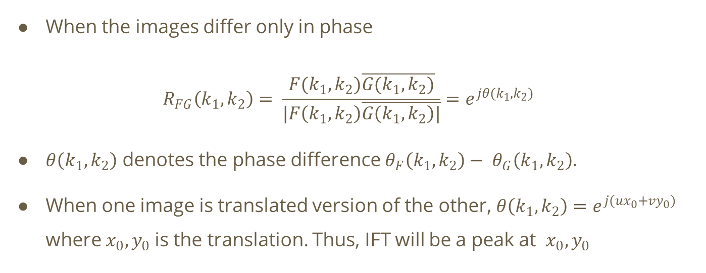
Algorithm

Slide 10
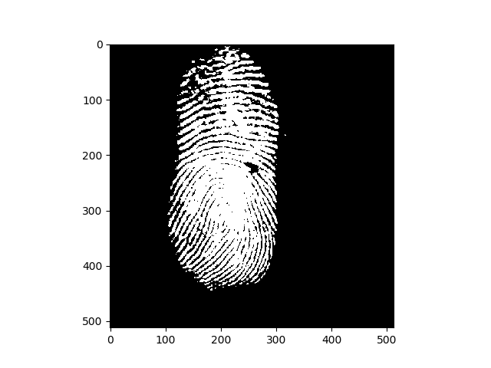
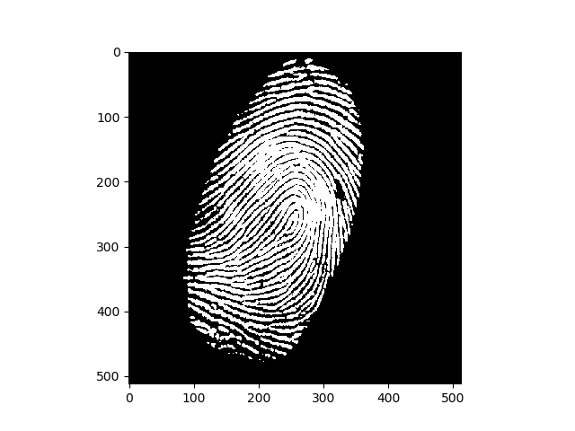
Algorithm - Rotation and Translation

Slide 11
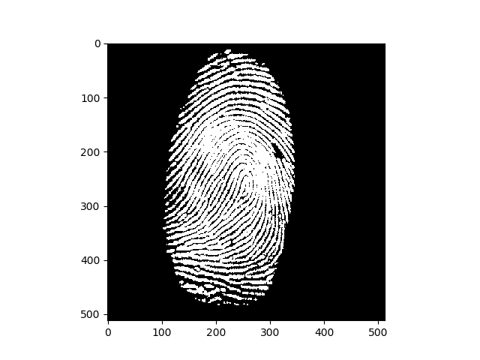
Algorithm - Rotation and Translation

Slide 12
Common Region Extraction
Overlapping region of the images was extracted
This improves the accuracy of fingerprint matching, since the non overlapped areas of the two images become the uncorrelated noise components in the BLPOC function
The effective fingerprint areas in the registered and the input image is examined using the n1-axis and the n2-axis projection of pixel values.
The common effective image areas, are extracted for the succeeding image matching step

Slide 13
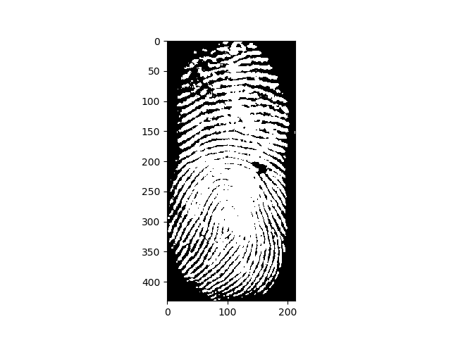
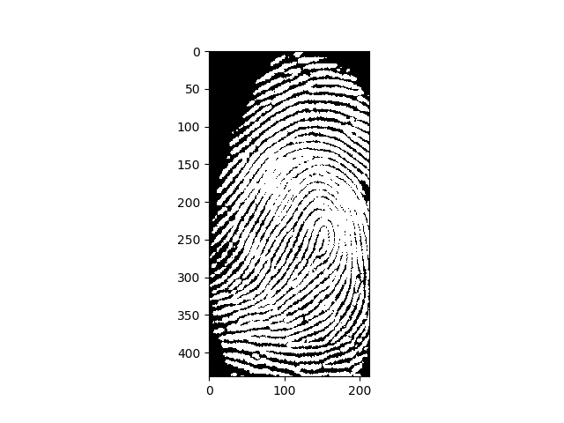
Common Region Extraction

Slide 14
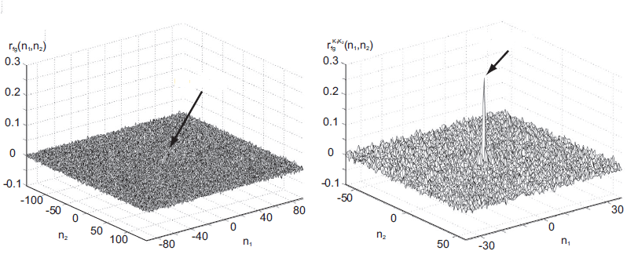
Algorithm
Fingerprints match when BLPOC has a sharp peak
Matching score = sum of two highest peaks of BLPOC

Slide 15
Results
Following is a subset of results obtained by the above algorithm
P1 vs P1 | P2 vs P2 | P3 vs P3 | P4 vs P4 | P5 vs P5
0.028 | 0.019 | 0.007 | 0.032 | 0.002
P1 vs P2 | P2 vs P3 | P3 vs P4 | P4 vs P5 | P5 vs P6
0.003 | 0.023 | 0.002 | 0.005 | 0.021

Slide 16
References
[1] Ito, Kiyoshi & Morita, A. & Aoki, Takiko & Higuchi, Takuma & Nakajima, H. & Kobayashi, K.. (2005). A fingerprint recognition algorithm using phase-based image matching for low-quality fingerprints. Proceedings - International Conference on Image Processing, ICIP. 2. II - 33. 10.1109/ICIP.2005.1529984.
[2] FVC2004 web site: http://bias.csr.unibo.it/fvc2004
[3] M. Kawagoe and A. Tojo, “Fingerprint pattern classification,” Pattern Recognition, vol. 17, no. 3, pp. 295–303,1984

